Slide 1
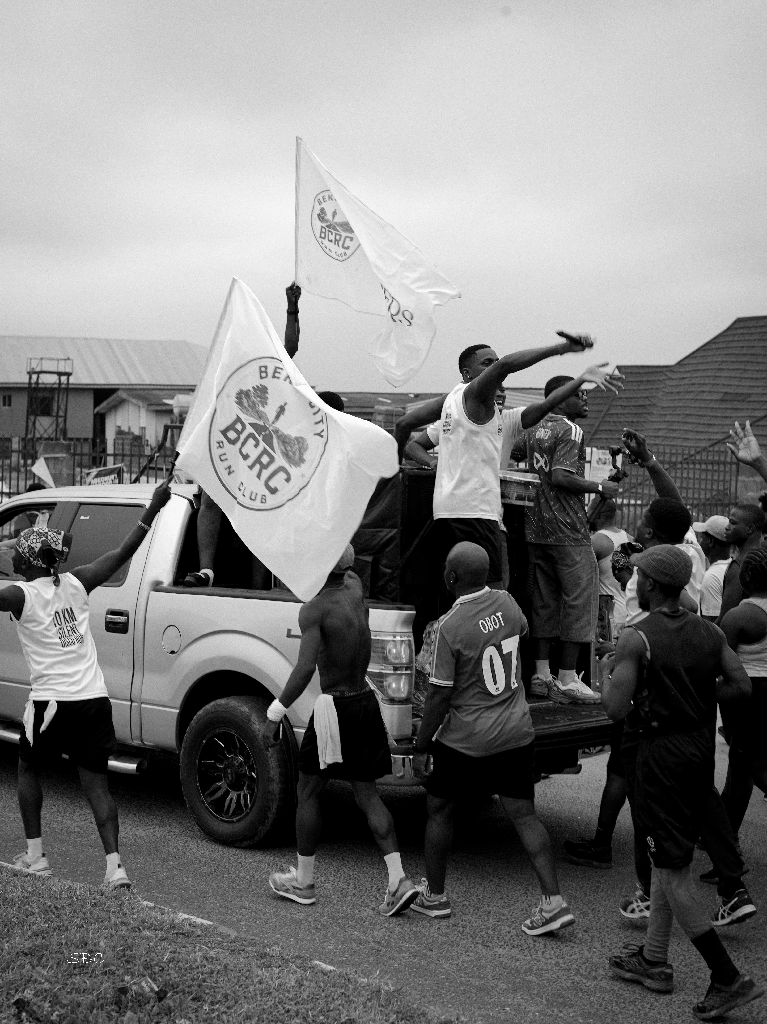

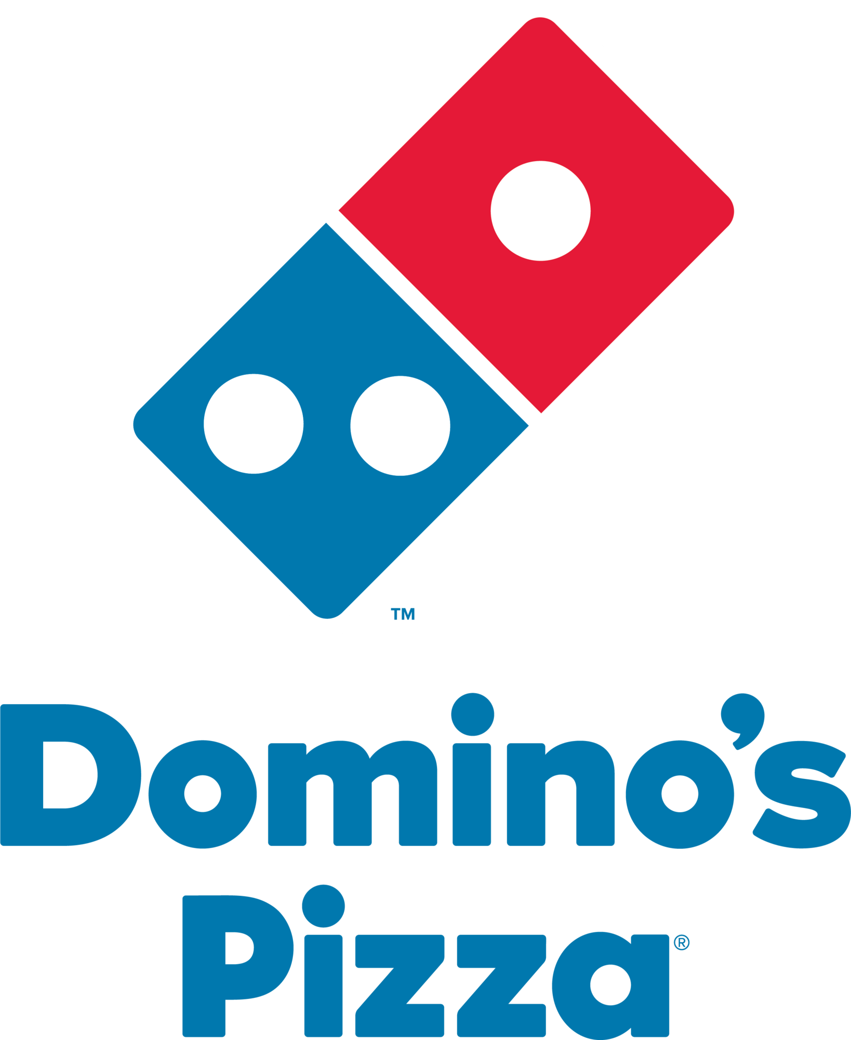

PARTNERSHIP & SPONSORSHIP PROPOSAL
BEKS CITY RUN CLUB
in partnership with ARCHERS LIVE
Put your brand in front of Abeokuta's most engaged running community, and turn every run into reach, product trial and loyalty.
Prepared for: DOMINO’S PIZZA | 6th October 2026

Slide 2
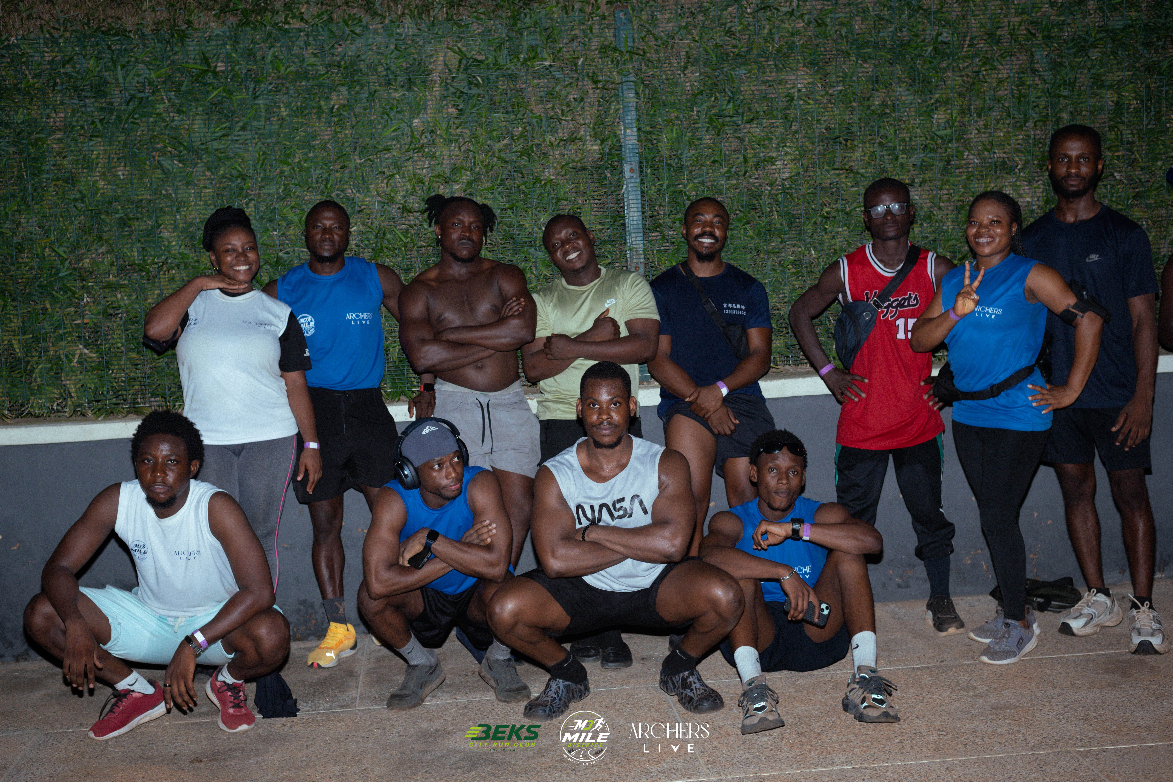
A NOTE FROM THE FOUNDERS
PREPARED FOR
Dear Partner,
COMPANY
DOMINO’S PIZZA
On behalf of BEKS CITY RUN CLUB, thank you for considering a partnership built around one thing: results for your brand. We put you in front of one of Abeokuta's most active, engaged, and fastest-growing audiences, in a setting where people are open to discovering new brands.
Founded in May 2026, BEKS CITY RUN CLUB has grown into a community of 600+ members, with 250+ runners showing up every week. They are health-conscious runners, professionals and entrepreneurs, and they back the brands that show up for them.
Every event is produced to a professional, world-class standard in partnership with ARCHERS LIVE, our official production partner and event organizer, so your brand is always presented in a polished, well-run environment.
CONTACT
MARKETING MANAGER
DATE
6th October 2026
02

Slide 3
WHY PARTNER WITH US
What Your Brand Gains
This is a two-way partnership, not a donation. Every tier is built around measurable brand exposure, direct sampling and reusable content, in a community that is hard to reach through traditional advertising.
1
Repeated, weekly exposure
250+ runners show up every week, so your brand is seen again and again, not just once at a flagship event. Frequency builds recall.
2
Reach beyond the run
We work with creators who have large audiences, so every partnership travels beyond our community. Our content has earned 2.5M+ views.
3
A high-intent audience, face to face
Runners, professionals and entrepreneurs across three districts (Mile, Funaab and Pharmafit): a health-conscious consumer base you can meet and sample to directly.
4
Content you can reuse
Joint reels, features and event moments give you organic, shareable content that keeps working for your brand long after event day.
5
A polished stage for your brand
Every activation is delivered by Archers Live to a professional standard, so your brand is always presented in a well-run, well-attended setting.
03

Slide 4
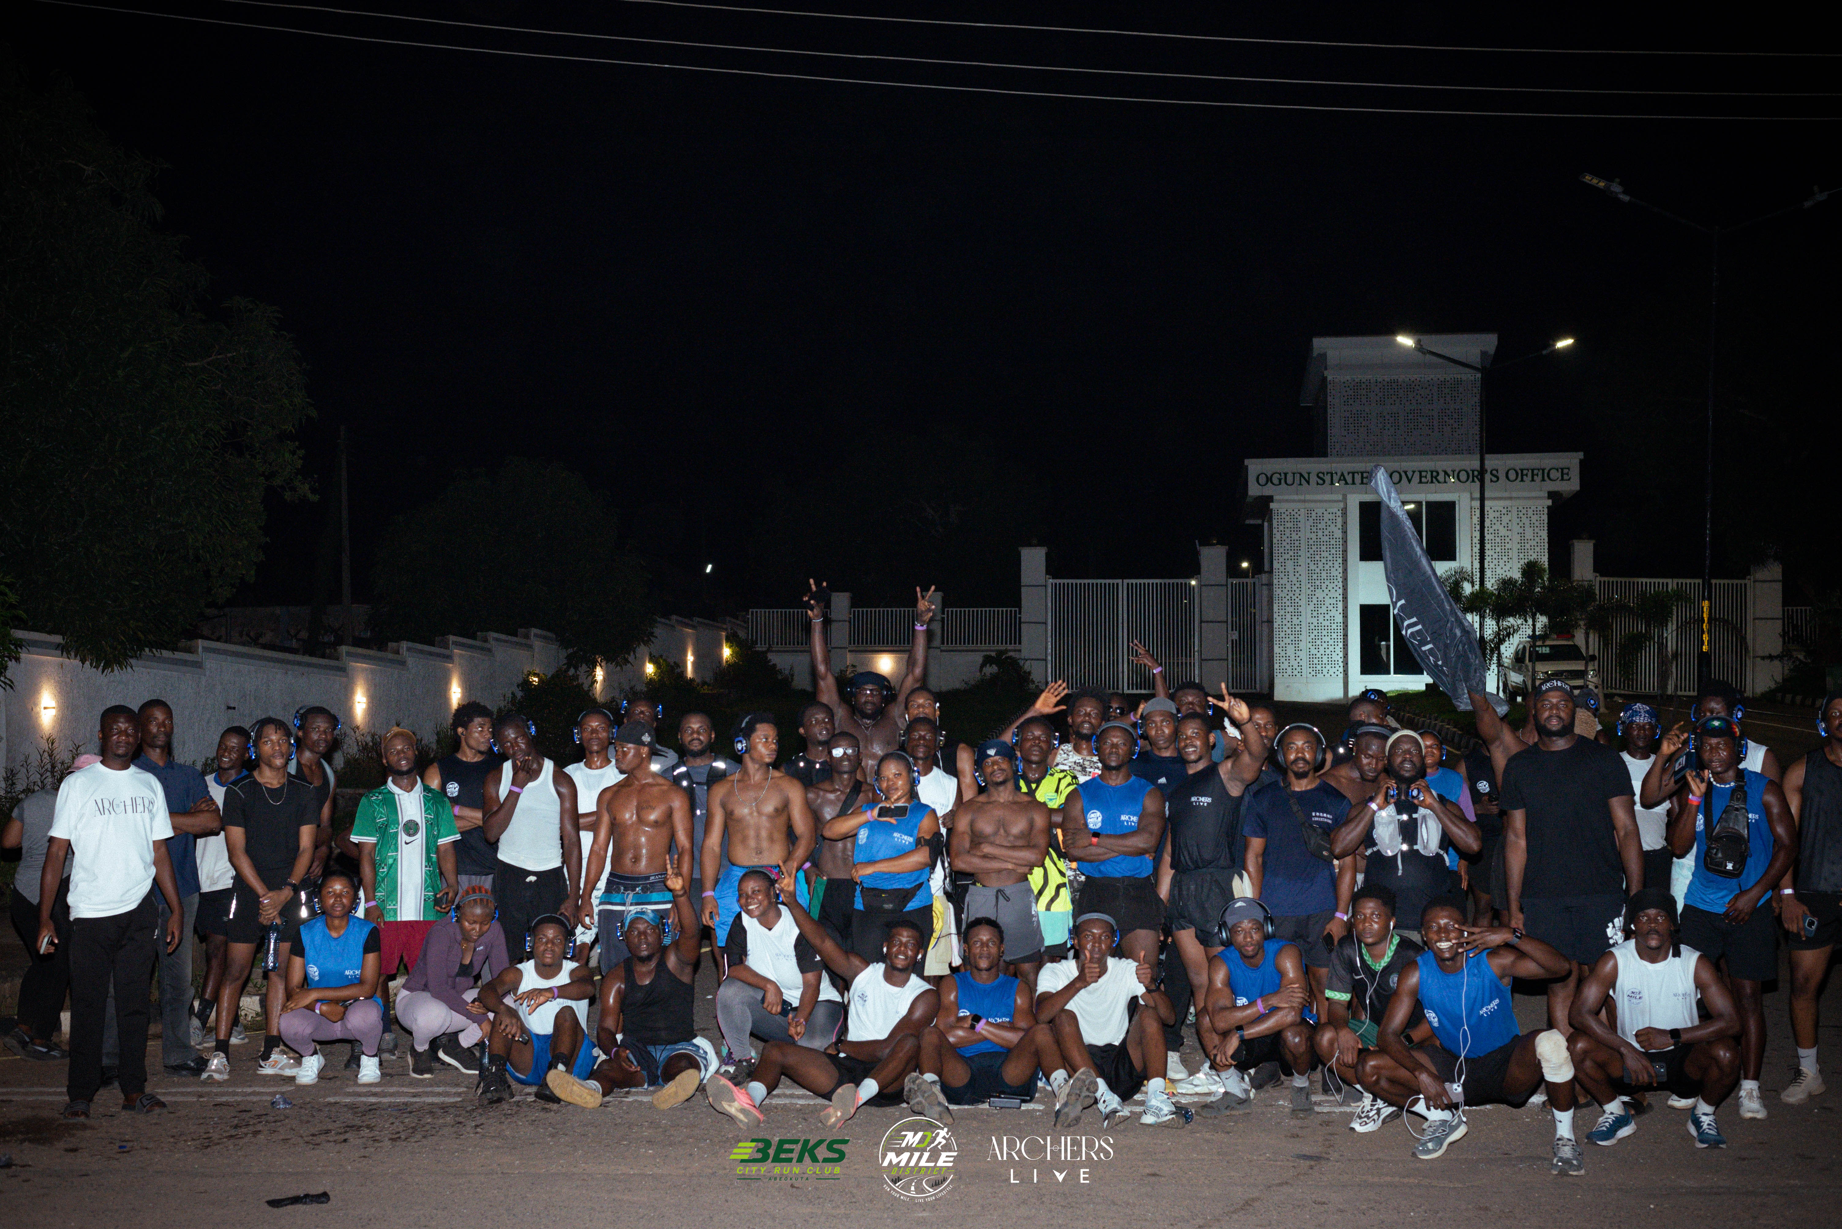
YOUR AUDIENCE
The Audience You Gain Access To
600+
250+
2.5M+
750+
Community members
Average weekly runners
Social media views
Attendees at our largest event
Every number is people who chose to show up: actual footsteps, not impressions. That is the audience your brand meets.
04

Slide 5
THE RETURN ON YOUR SPONSORSHIP
How Your Brand Wins
1
2
3
Be Seen
Be Tried
Be Remembered
Your logo on flyers, banners and stands at events and weekly runs, plus brand shoutouts and social features, amplified by creators with large audiences.
Live sampling puts your product in the hands of active, health-conscious people, with direct engagement with up to 300 attendees at a single event.
Co-branded content, official partner recognition and CSR credentials build lasting goodwill long after the finish line.
05

Slide 6
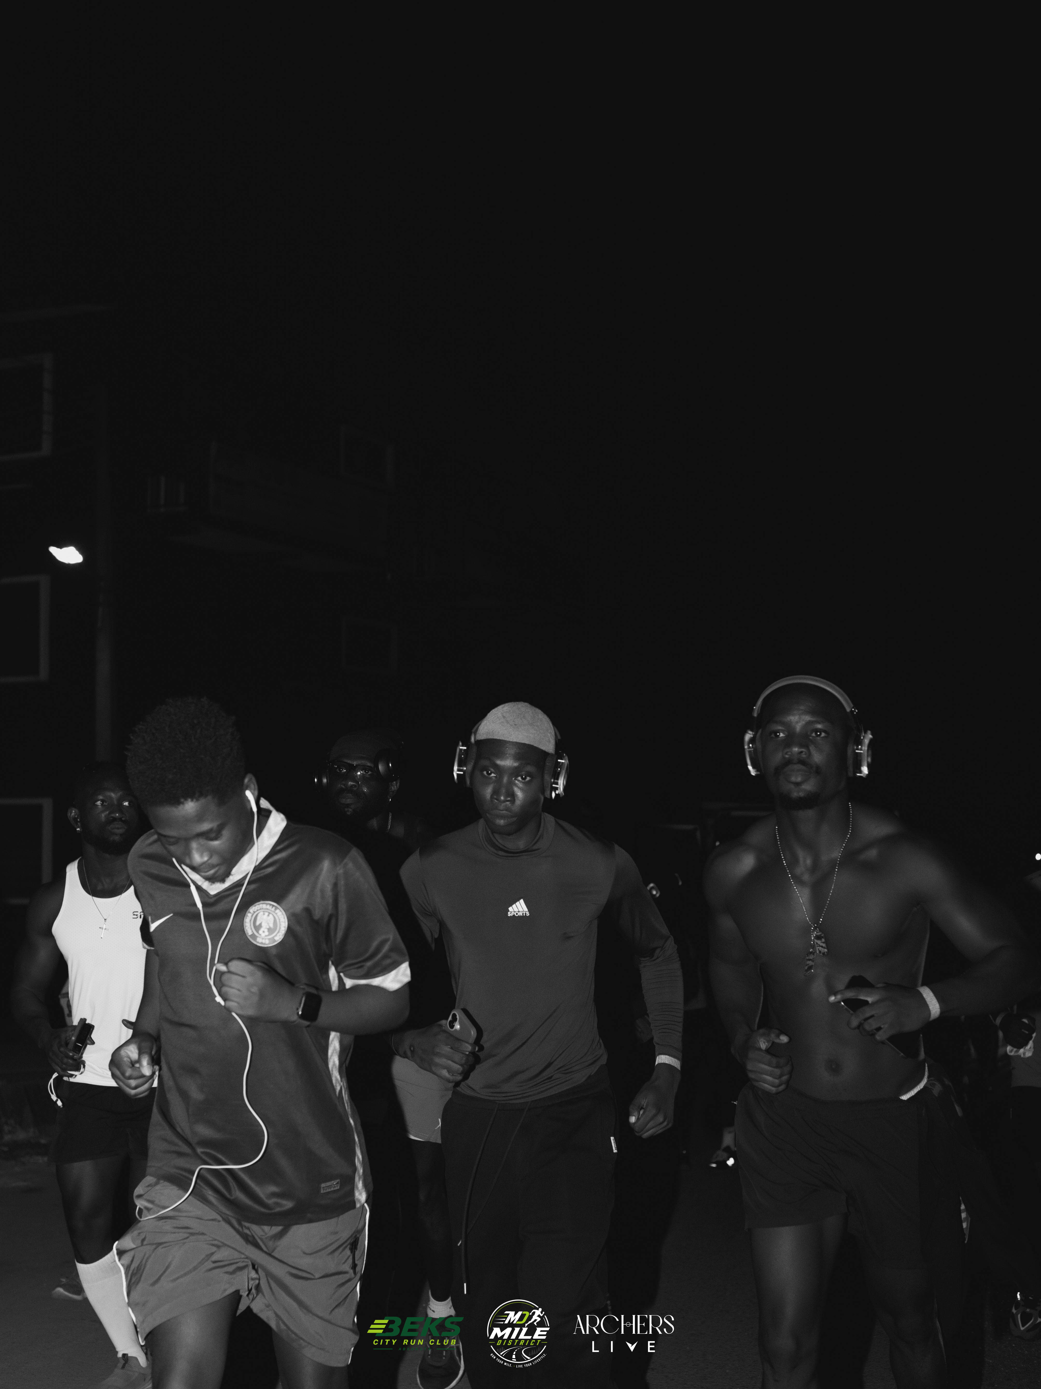
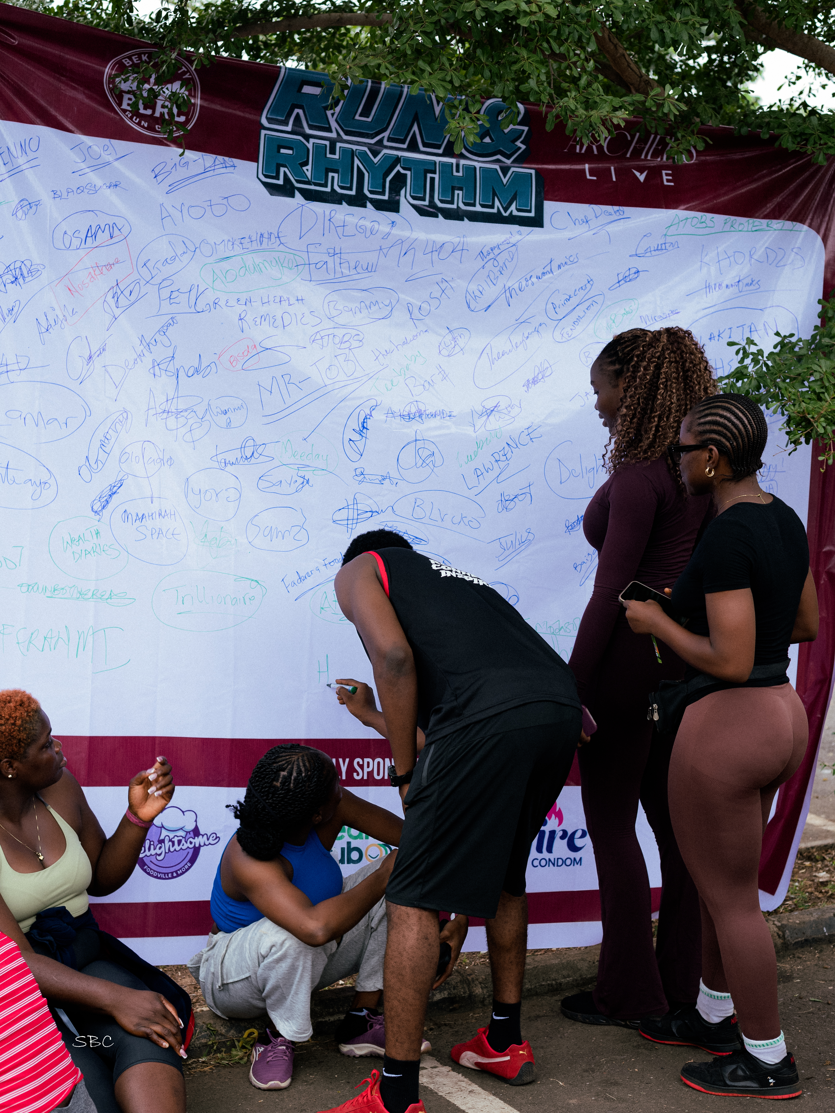
PROOF OF DELIVERY
A Track Record You Can Build On
In a short time, we have proven we can pull a crowd. Turnout more than doubled from our debut to our second flagship event, so each activation puts your brand in front of a bigger audience.
DEBUT EVENT
FLAGSHIP EVENT
Silent Run
Run & Rhythm
Our debut community event drew over 250 participants and put the club on Abeokuta's map.
Our second flagship event grew to 600+ runners and 50 volunteers, more than double our debut turnout.
250+ participants
700+ runners · 50 volunteers
06

Slide 7
WHAT DRIVES US
Mission, Vision & Aim
1
2
3
Mission
Vision
Aim
To bring people together through group running building and sharing a healthier lifestyle.
To grow into a lifestyle brand that goes beyond running: a movement connecting people, partners and purpose, powering healthier communities on and off the road.
To encourage people to become active in their fitness journey in the most lively and enjoyable way possible.
07

Slide 8
UPCOMING ACTIVATION
Run & Rumble
ARCHERS LIVE × THE GAME XPERIENCE
31 OCTOBER 2026
RUN &
RUMBLE
Run & Rumble: The Playground Experience is our October flagship, with Archers Live and The Game Xperience. A 7KM community run from Moore Junction to MKO Abiola Stadium meets the childhood games everyone remembers, giving your brand a high-energy, nostalgic setting to connect with runners.
What your brand can do on the day:
THE PLAYGROUND EXPERIENCE
Sample your product to an active, engaged crowd
7KM RUN · MOORE JUNCTION TO MKO ABIOLA STADIUM
Tell your brand story live, in front of runners
Capture organic content at a highly shareable event
PS2 · Police & Thief · Suwe · Table Tennis · Rubber · Ten Ten · Idi Oremi · Tinko · Sack Race
08

Slide 9
INVESTMENT & RETURN
Partnership Tiers
Choose the level of exposure that fits your goals and budget, from a no-cost, in-kind contribution to a full-quarter, co-branded partnership. All billing on paid tiers is capped at three months.
QUARTZ
EMERALD
SAPPHIRE
DIAMOND
In-Kind
₦500,000
₦1,500,000
₦2,000,000
No cash required
per event
per quarter
per quarter · flagship
BEST VALUE
Not sure which tier fits? Quartz is the easiest way to test the waters with an in-kind contribution. Emerald puts your brand in front of up to 300 attendees at a single event, while Sapphire and Diamond build quarter-long visibility, recall and relationships with our members.
09

Slide 10
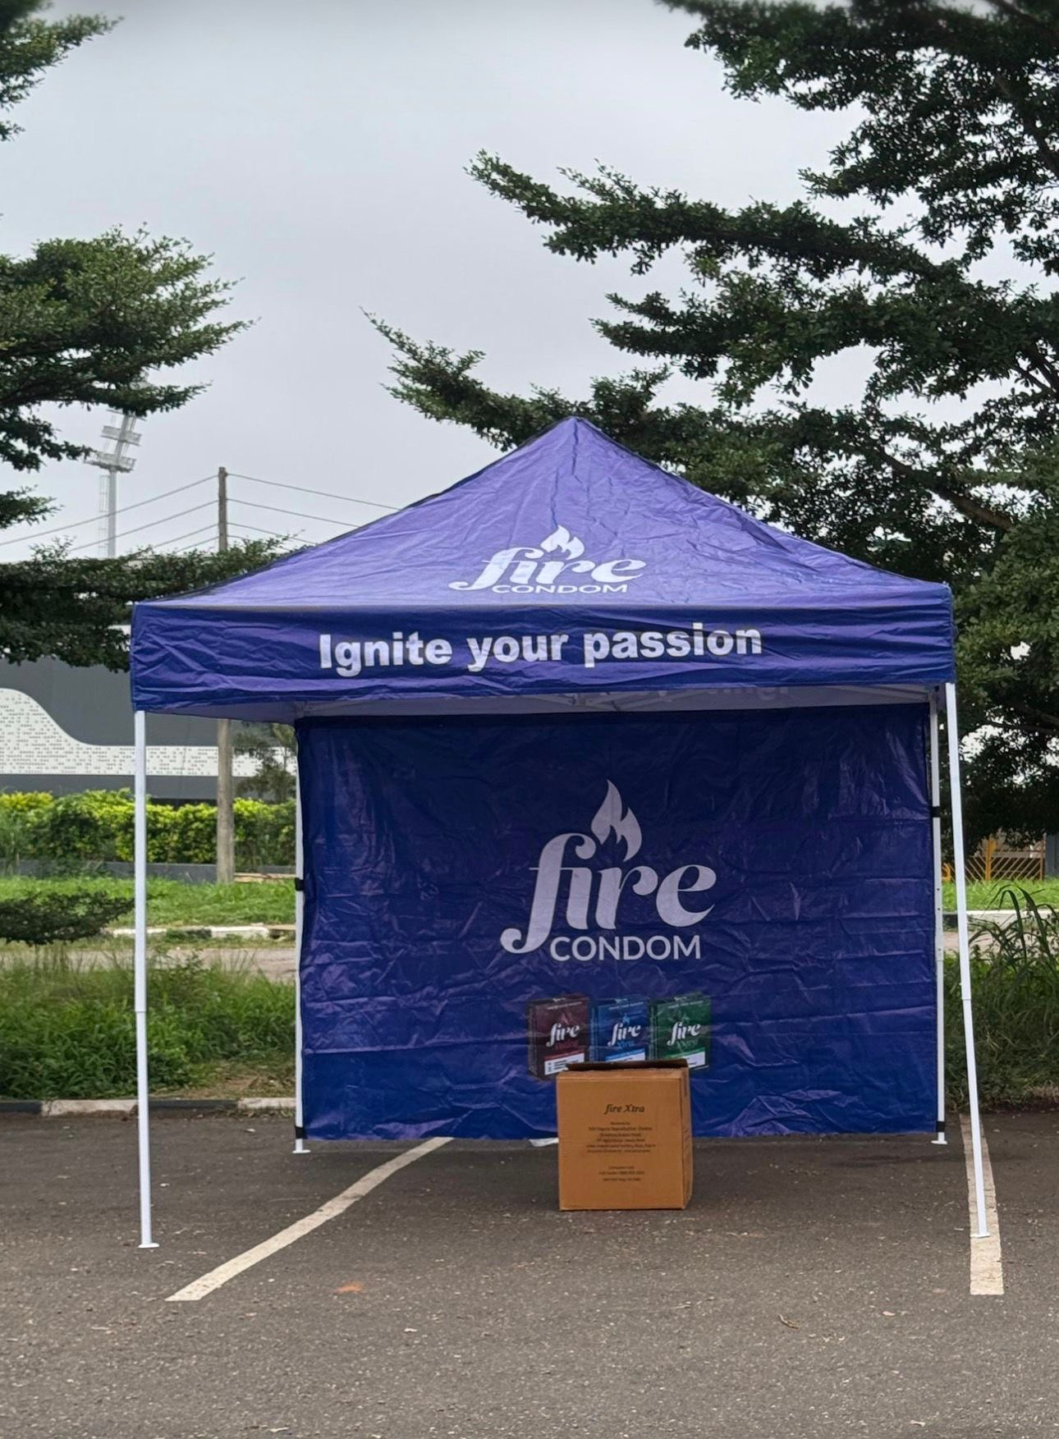
TIER DETAIL
Quartz — In-Kind Partnership
Zero cash, real exposure. Sponsor an event with whatever you have to give (food, refreshments, cash or product) and bring your team to sample directly to our runners.
Contribute in kind: food, refreshments, cash or products, whatever fits your brand
Bring your own products or team to the event for live sampling to attendees
Company logo on the event flyer, in front of our whole audience
Brand shoutout and mention during the event
Zero cash commitment: the easiest way to get in front of our community
10

Slide 11
TIER DETAIL
Emerald, Sapphire & Diamond
EMERALD
SAPPHIRE
DIAMOND
₦500,000
₦1,500,000
₦2,000,000
per event
per quarter
per quarter · flagship
A low-risk way to see the return at a single event
Sustained exposure across 2 of 3 running districts
Maximum exposure across all three running districts
Branded stand or booth at the event venue
Branded stand/banner at weekly runs, every week, all quarter
Branded stand/banner at every weekly run, all quarter
Company banner and signage displayed on-site
Product sampling at every weekly run in those districts
Product sampling at every run and every community event
Live product sampling to attendees on event day
Stand and sampling at 2 major community events
Weekly/bi-weekly social shoutouts and content collabs
Logo placement on event flyers and press materials
4–6 social media features, including one joint content piece (reel, interview, or feature)
Official co-branding on all club materials and vests
2–3 dedicated social media posts/stories
Recognized as an official CSR partner in materials
First right of refusal on employee wellness programs
Direct engagement with up to 300 attendees
Direct engagement with 100+ members over the quarter
Direct engagement with 200+ members all quarter, named and recognized at every community event
11

Slide 12
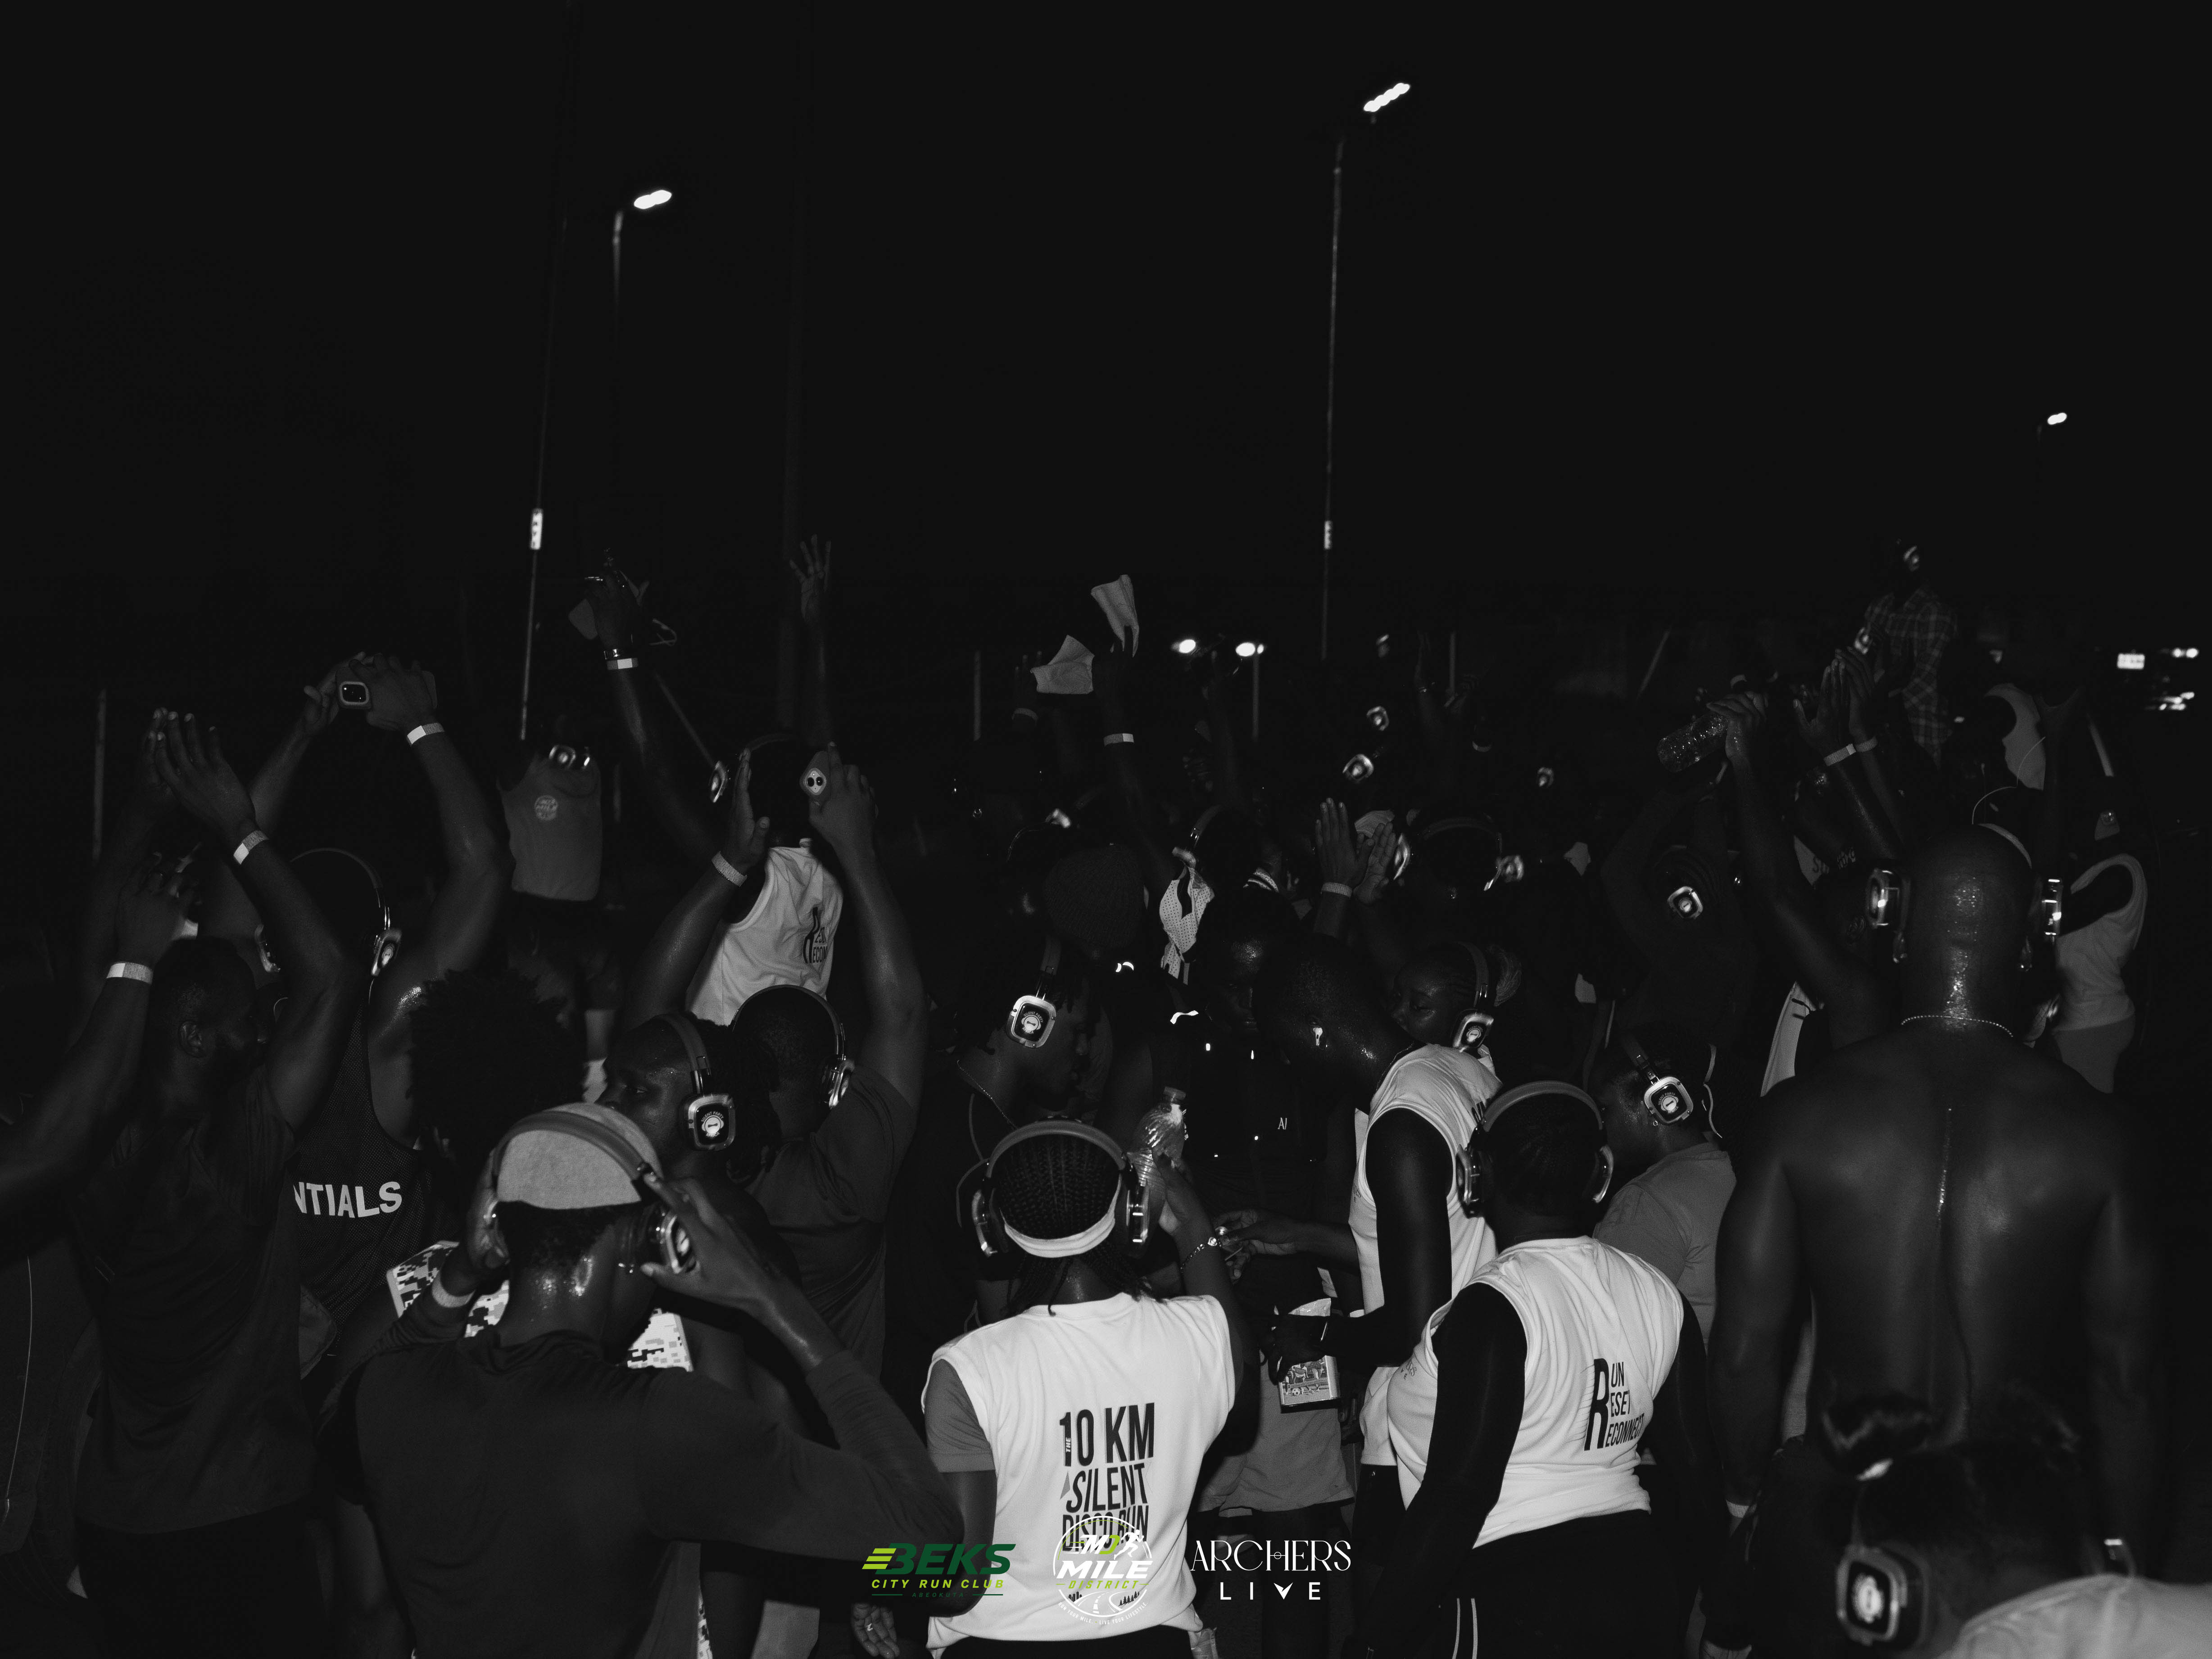
LET'S BUILD A HEALTHIER ABEOKUTA
Together.
Whichever tier fits your goals, what you gain is more than visibility: face-to-face engagement, content you can reuse, and the trust of an active, growing community that shows up for the brands that show up for it.
Join us at Run & Rumble on 31st October, or let's talk about the tier that fits your brand. We would welcome the chance to meet your team.
YOURS FAITHFULLY, FOR AND ON BEHALF OF BEKS CITY RUN CLUB
Adebanjo Oluwatobiloba · Tijani Pelumi
Oladipupo Abdul Azeez · Shittu Ismail
12

Slide 13
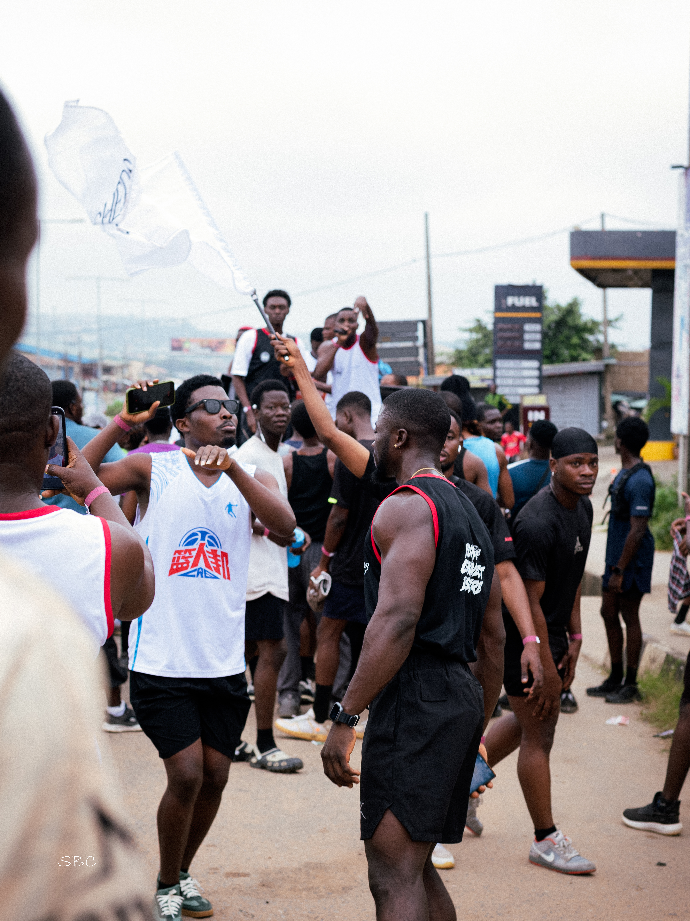

GET IN TOUCH
Let's Talk Partnership
PHONE
07069582118, 08168120117
EMAIL
Bekscityrunclub@gmail.com
INSTAGRAM
Beks.cityrunclub
LOCATION
Abeokuta, Ogun State
13

